Slide 1

Bangladesh Army University of Science and Technology (BAUST)
Course: Software Development Project II
Edit Ease
Presented by:
M. M. Omar
ID: 0802320205101001
Presented to:
Munira Akter Mou
Lecturer
MD. Maskur Al Shal Sabil
Lecturer

Slide 2
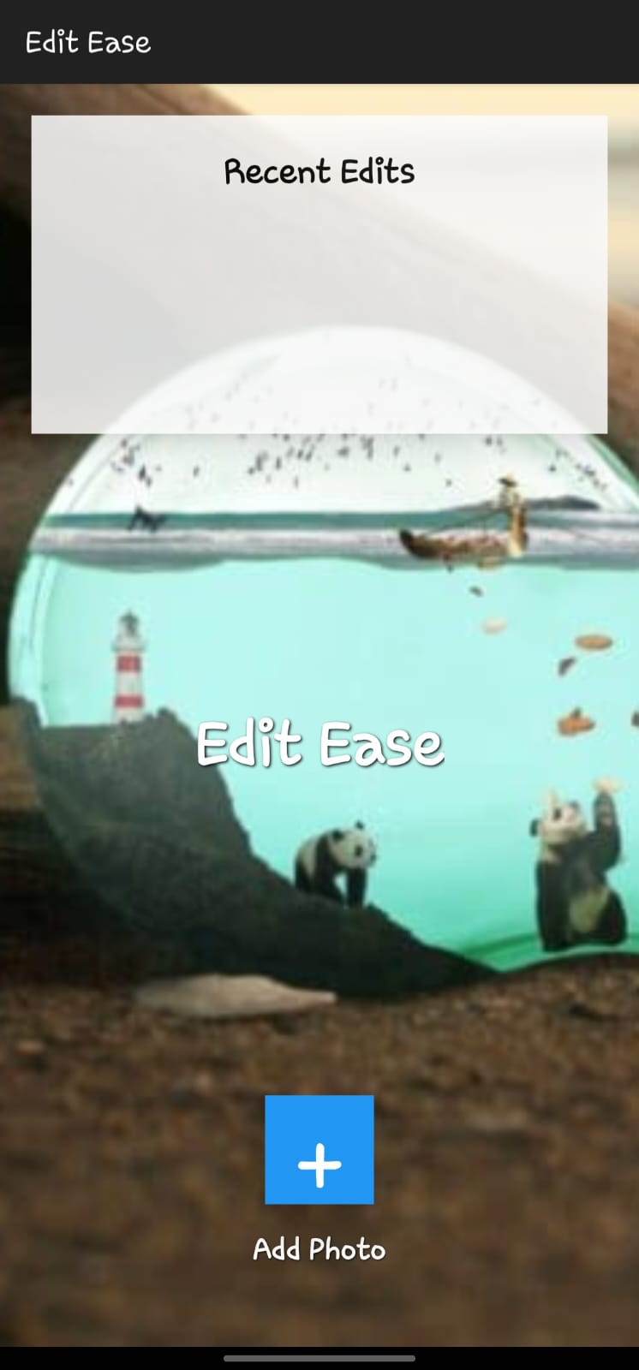
Edit Ease: Simplifying Image Editing on Android
Edit Ease is an Android image editing application meticulously developed for Casual users. It offers a comprehensive suite of tools, empowering users to modify and enhance their images through an intuitive user interface

Slide 3
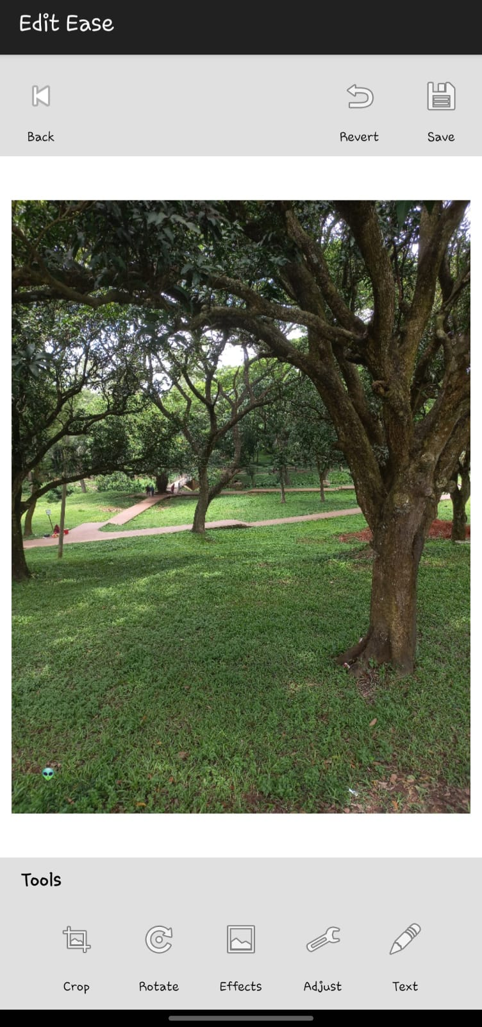

Core Features: Enhancing Your Visuals
Basic Editing Capabilities
Unleash your creativity with essential editing tools. Precisely crop images with a 3x3 grid overlay, rotate them 90 degrees with ease, and save your masterpieces directly to the device gallery, preserving all applied edits.
3

Slide 4
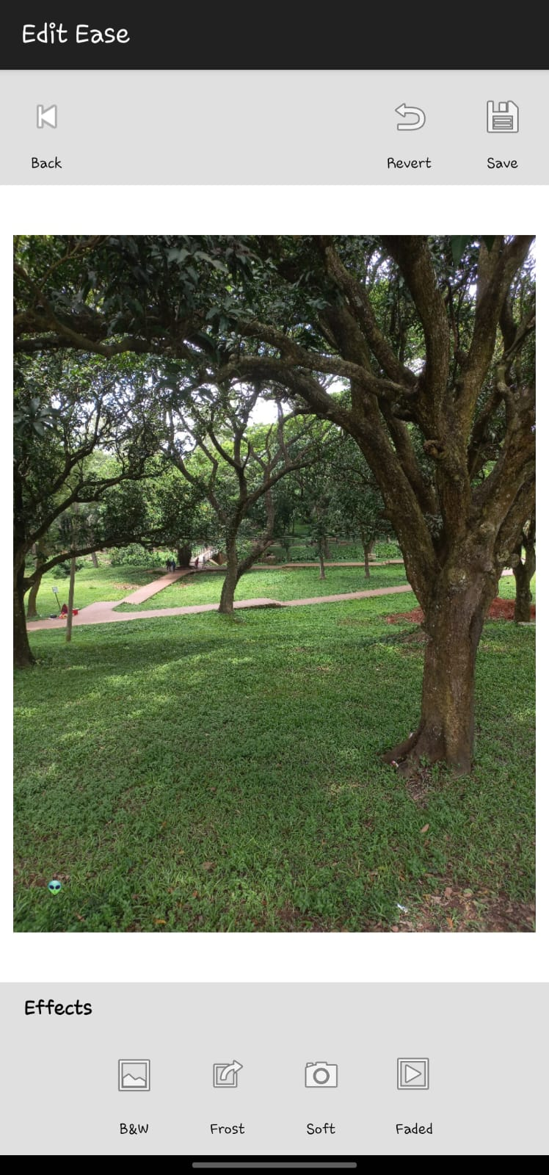
Core Features: Enhancing Your Visuals
Creative Filter Effects
Transform your photos with a selection of artistic filters: Black & White for classic desaturation, Frost Filter for cool tones with adjustable intensity, Soft Filter for gentle blur and warmth, and Faded Filter for a vintage aesthetic.
4

Slide 5
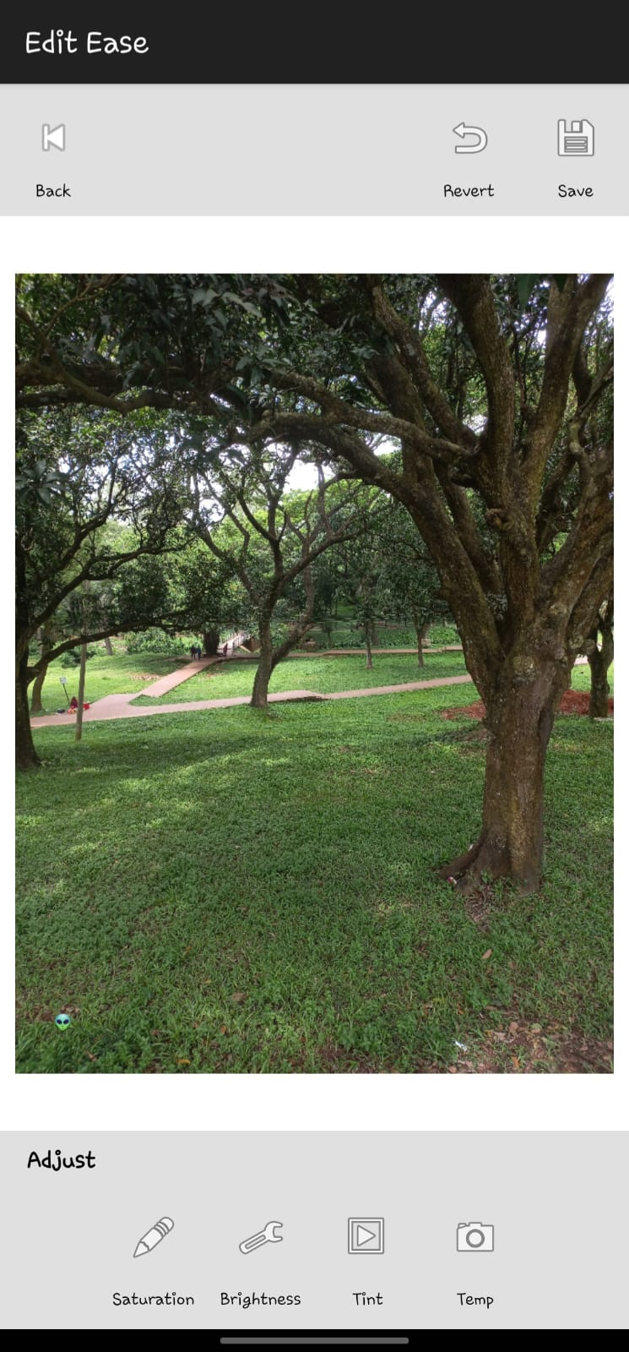
Core Features: Enhancing Your Visuals
Advanced Adjustment Controls
Fine-tune your images with granular control over saturation for colour intensity, brightness for lightness/darkness, tint for red/green colour temperature, and temperature for yellow/blue colour balance.
5

Slide 6
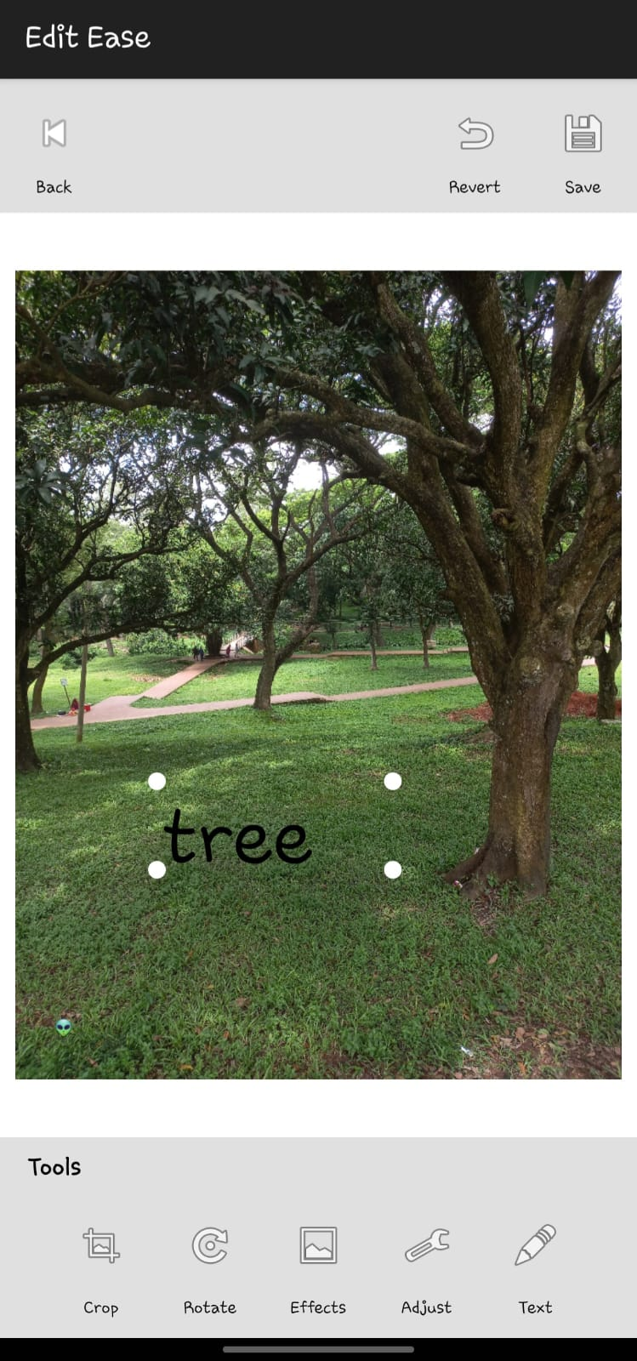
Dynamic Text Overlay System
The text overlay system in Edit Ease provides flexibility and customisation, allowing users to add messages to their images.
Text Placement: Effortlessly add text with a centered text box and an intuitive user input dialog.
Drag & Resize: Enjoy full control with draggable and resizable text boxes, with responsive corner handles for precise adjustments.
Text Persistence: Your text stays exactly where you left it, maintaining its position and styling through subsequent editing sessions.
Proportional Sizing: Text size intelligently adjusts with the dimensions of its containing box, ensuring optimal readability.
6

Slide 7
Technical Foundation: Android Components & Graphics
Edit Ease is built upon a user first architecture, utilizing a comprehensive set of Android components and graphics APIs to deliver its powerful editing capabilities.
Android Components
Core Android APIs
Graphics & Image Processing
Intuitive UI Components
Leveraging Activities for core screens, Views like CustomImageView and SeekBar for UI elements, and Layouts such as LinearLayout and RelativeLayout for responsive design.
Integrating Media Store for image management, ExitInterface for orientation detection, and ColorMatrix for sophisticated colour adjustments.
Utilising Bitmap Operations for image manipulation, ColorMatrix for advanced adjustments, Matrix Transformations for precise scaling and rotation, and Canvas Drawing for overlays.
Featuring a streamlined Toolbar System for navigation, dedicated panels for Tool Selection, Effects, and Adjustments, all controlled by responsive Slider Controls.
7

Slide 8

Project Scope: Learning Experience in Android Development
Touch Handling
Image Processing
UI/UX Design
Lifecycle & Memory
8
This application showcases a deep understanding of core Android concepts, from complex image processing algorithms to intuitive user experience design, solidifying its value as a practical and theoretical learning tool.

Slide 9
Thank you!

